Slide 1

Intruder alert System
Group Name: Flamingo
Group Members:
Asmaul Husna Rima
ID: 182002003
MD Shahrior Shawon Prio
ID: 192002032
Jerin Joti Alamgir
ID: 182002063

Slide 2

CONTEXT
Prototype
Our goals of flamingo security prototyping.
Our journey to the prototyping process.
A rough sketch
Tools and techniques
The demo of the prototype
Feedback and evaluation
Conclusion

Slide 3

PROTOTYPE
A limited representation of a design that allows users to interact with it and to explore its suitability.
Allows stakeholders to interact with the envisioned product, gain some experience of using and explore imagined uses.
Production of an intermediary product to be used as a basis for testing.

Slide 4

OUR GOALS OF PROTOTYPING
Prototyping enables evaluation, happens throughout.
Exploring requirements.
Market analysis, participatory design.
Choosing among alternatives.
Risky or critical features, go/no-go decisions.
As early as possible, try out ideas with target users.
Evaluate our development.

Slide 5

OUR JOURNEY TO THE PROTOTYPING PROCESS
13/05/2022
GOALS
FUNCTIONALITY
DEVELOP
EVALUATE

Slide 6
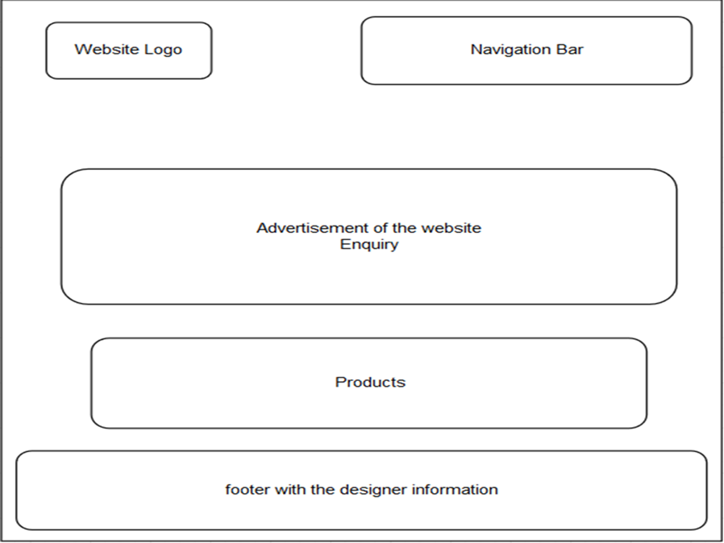
A ROUGH SKETCH
13/05/2022

Slide 7

TOOLS AND TECHNIQUES
13/05/2022
We used the online UI/UX designing tool figma.com to create our prototype.
It is easy and available for free use.

Slide 8
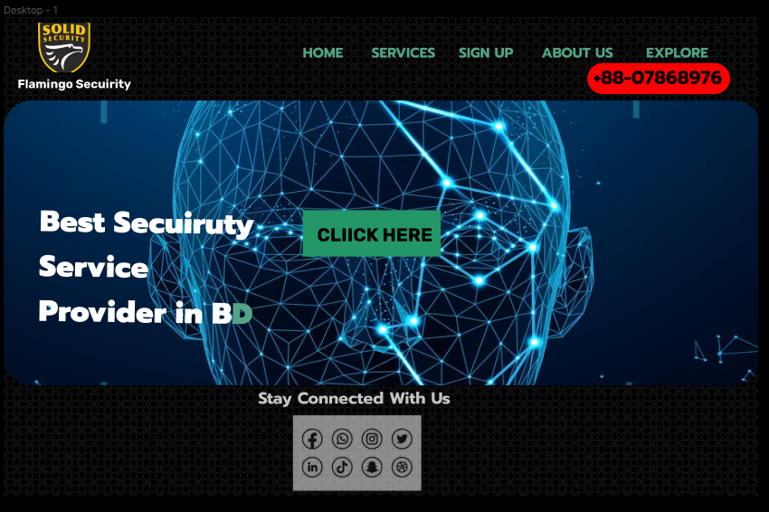
THE DEMO OF THE PROTOTYPE
13/05/2022
HOMEPAGE
8

Slide 9
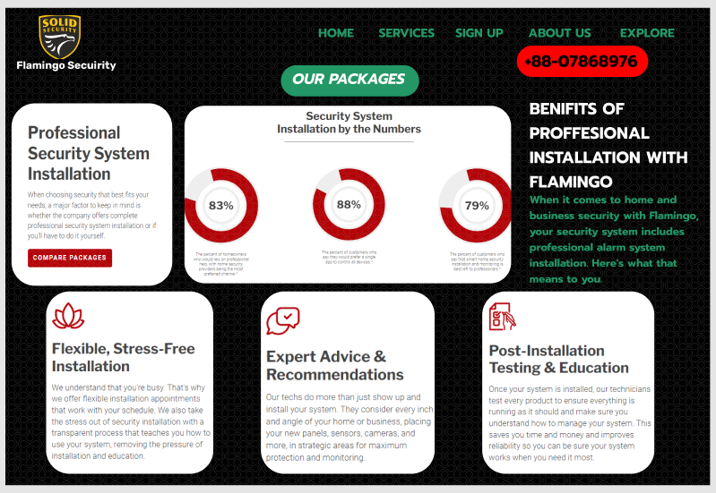
THE DEMO OF THE PROTOTYPE cont.
13/05/2022
SERVICES
9

Slide 10
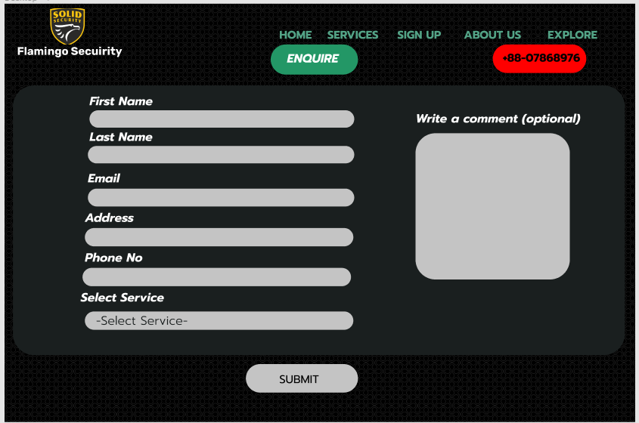
THE DEMO OF THE PROTOTYPE cont.
13/05/2022
SIGN-UP/ENQUIRY
10

Slide 11

THE DEMO OF THE PROTOTYPE cont.
13/05/2022
ABOUT US
11

Slide 12
FEEDBACK AND EVALUATION
13/05/2022
FEEDBACK
When we presented our demo on the online platform Figma, the prototype got well response from the audience.
The evaluation criteria were fulfilled.
We got one suggestion from the audience and which we really appreciate in order to make our services more perfect.
From the audience, one of them suggested, if any camera is not working or got any technical issue, the system will notify the authority and the support team immediately.
This is an important suggestion, and we will implement it ASAP.
12

Slide 13




Thank you
ANY QUESTIONS?

